Slide 1

Classification of plastics
Akiti Sri Kalyan Reddy

Slide 2
INTRODUCTION
In forensic research, infrared (IR) spectroscopy is a useful instrument for examining minute particles of materials like as paint, fibers, and tapes. It's excellent because it's affordable, simple to use, and doesn't obliterate the evidence.
Small particles can be analyzed by the procedure, and different sized particles can be analyzed using different techniques. They discuss how the integration of IR spectroscopy with other instruments has facilitated large-scale and small-scale material studies.
IR spectroscopy can be used to determine the possible origin of a material. It does, however, draw attention to the paucity of publications that describe the precise procedures by which scientists contrast the infrared signals from a questionable sample with those from recognized samples. They believe that further details on this topic would be helpful.

Slide 3
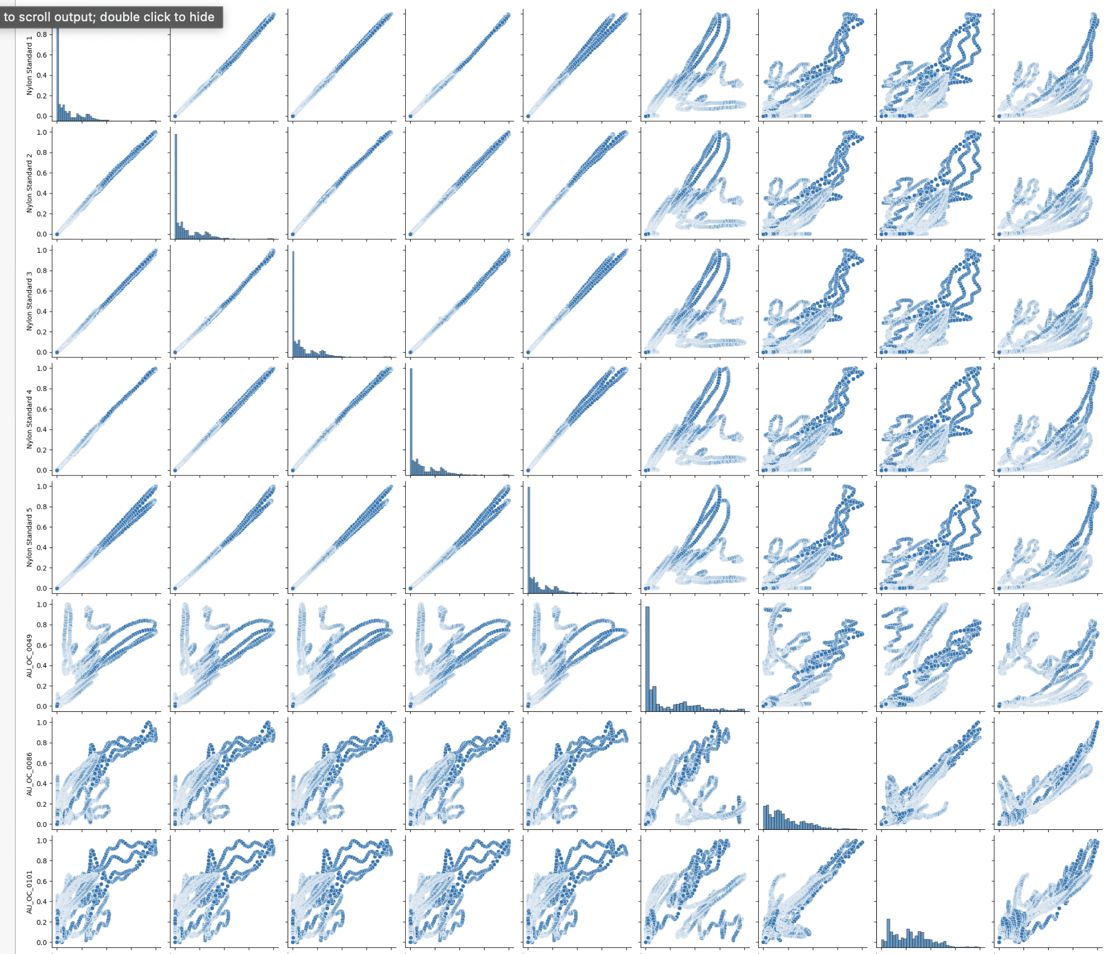
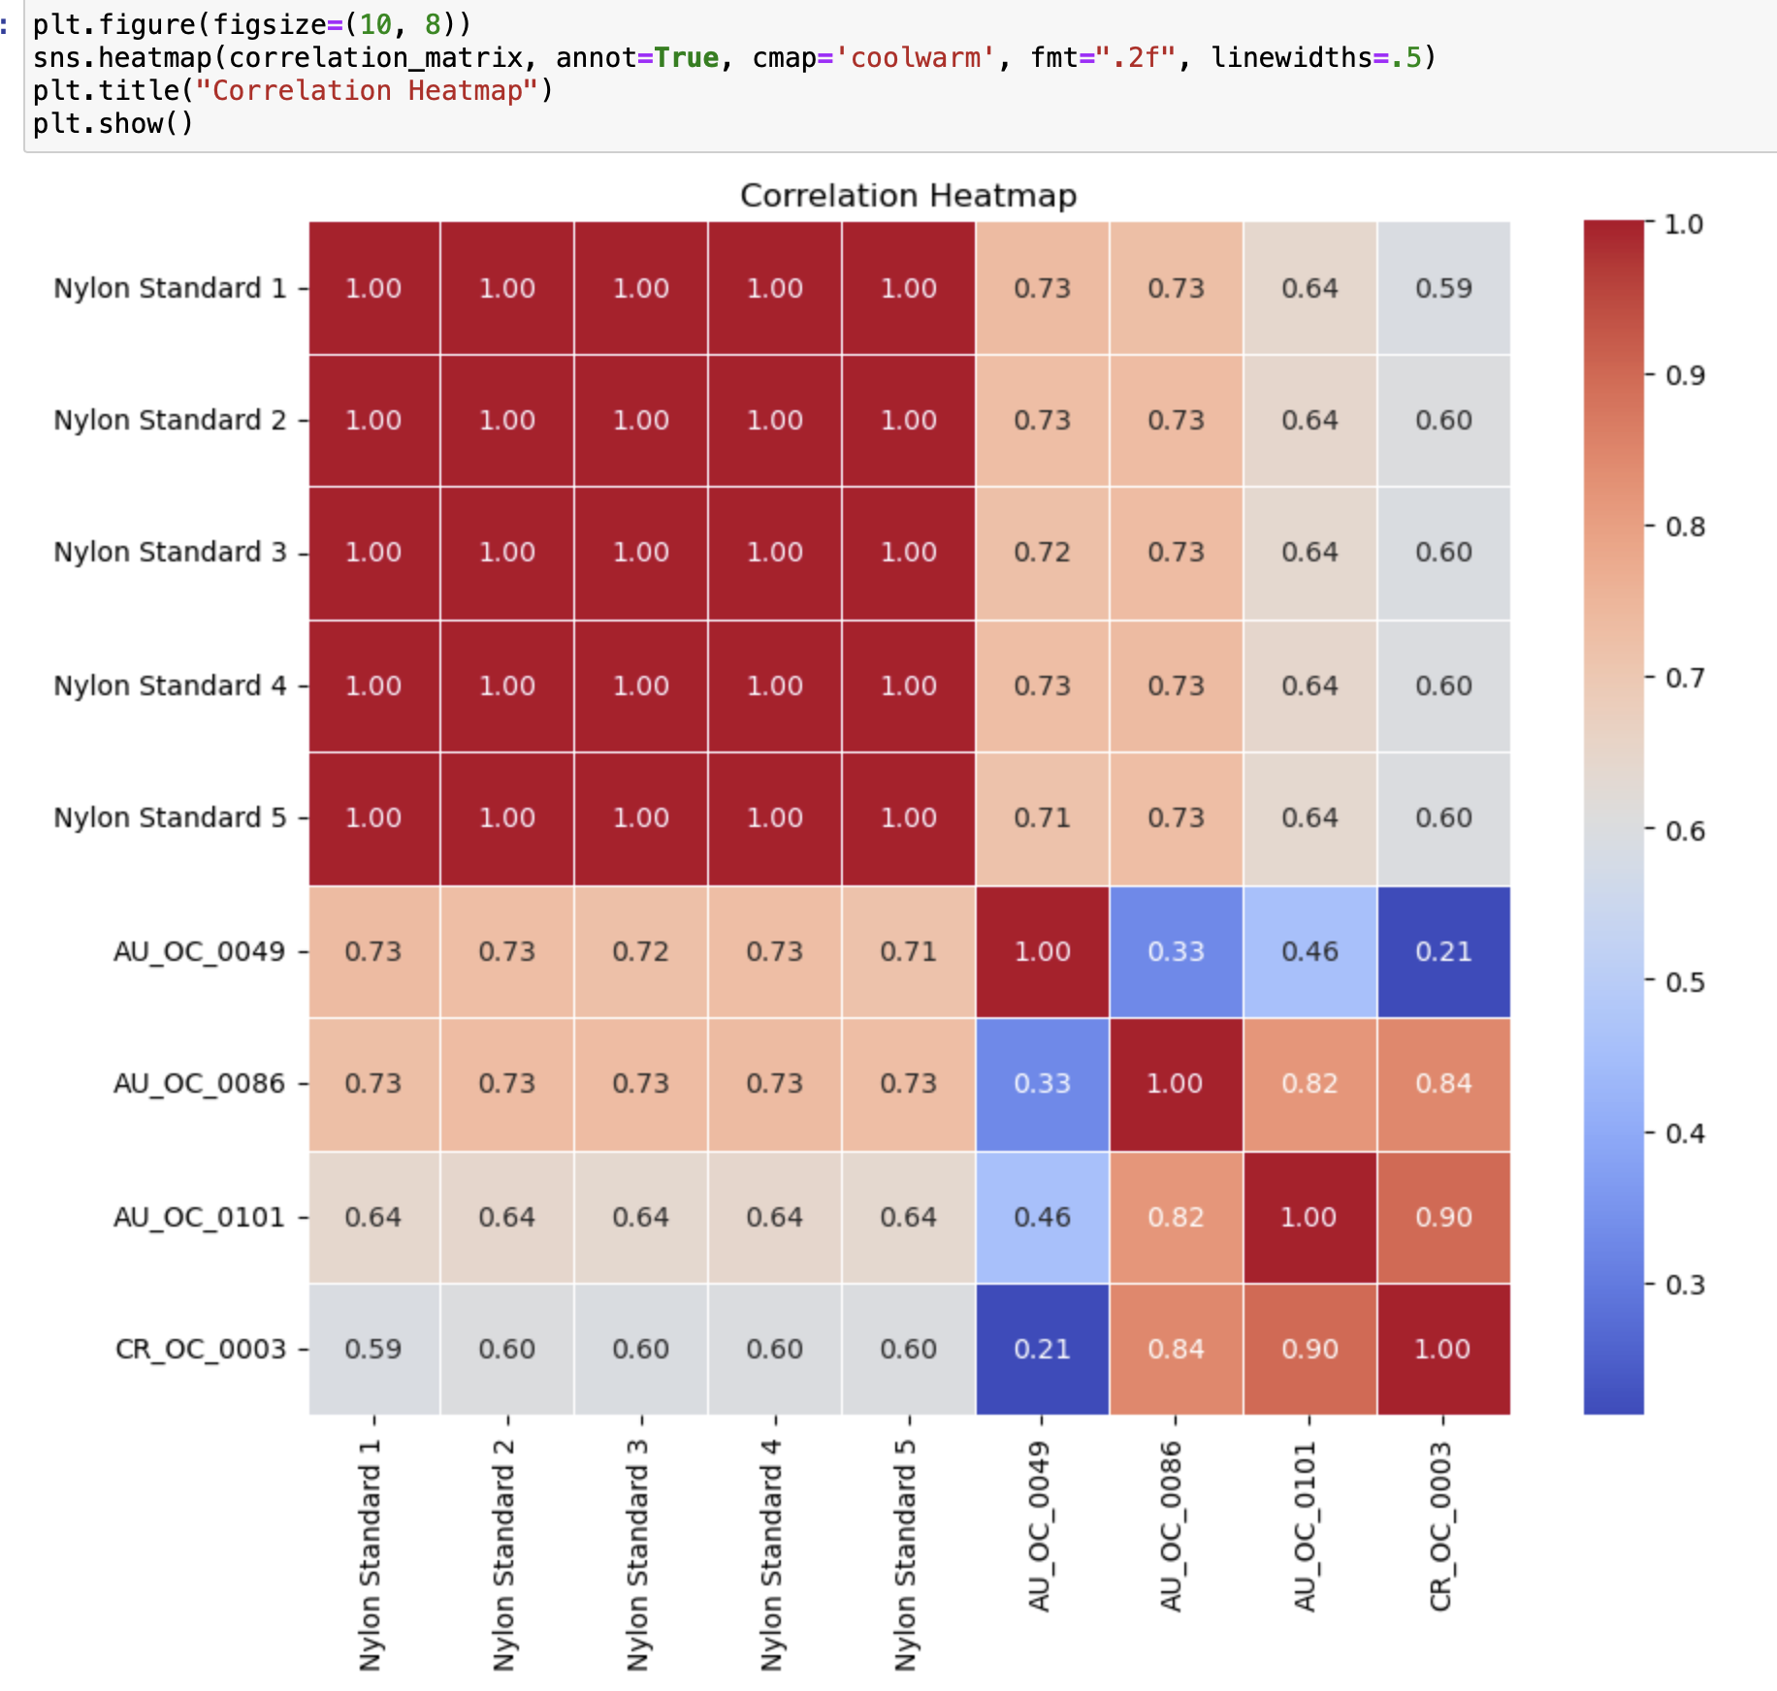
DATA VISUALIZATION
Data visualization is a crucial aspect of data analysis, involving the creation of visual representations to elucidate patterns, trends, and insights within complex datasets. By translating raw data into graphical formats such as charts, graphs, and maps, data visualization facilitates a more intuitive and accessible understanding of information. This visual storytelling not only enhances communication but also aids in uncovering meaningful correlations, making it an indispensable tool for decision-making in fields ranging from business and science to journalism and academia. The effectiveness of data visualization lies in its ability to simplify complex information, enabling individuals to grasp key findings and make informed decisions.

Slide 4
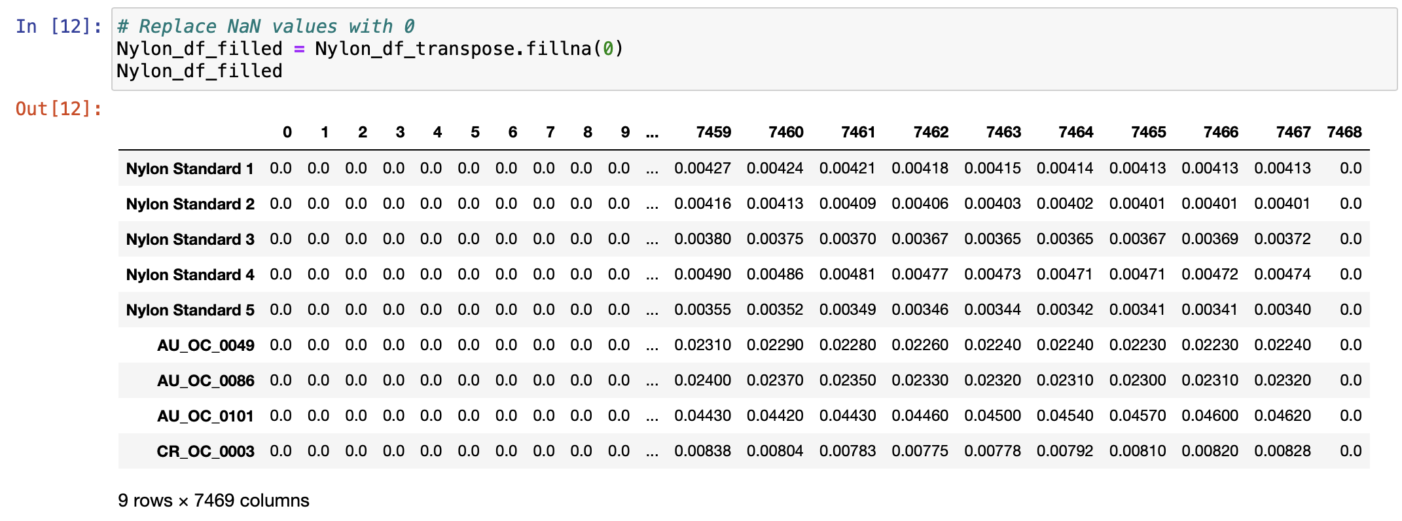
DATA CLEANING
Handling Missing Values:
Handling the dataset's missing values is a crucial part of data cleaning. This entails determining the appropriate course of action and identifying instances where data is lacking or incomplete. This could entail eliminating the rows that have missing values, using averages or other statistical measures to fill in the gaps, or using more sophisticated imputation methods. Resolving missing values guarantees a more accurate and comprehensive dataset for analysis.
Removing Duplicates:
Finding and deleting duplicate records is a crucial component of data cleaning. Duplicates can distort the findings of analyses and produce false insights. Identifying duplicate entries using attributes is a common step in data cleaning processes. Following this, decisions are made regarding whether to retain one instance of the data and eliminate the duplicates or combine the data from the duplicates.

Slide 5

DATA MODELING
Data modeling plays a crucial role in creating a blueprint for databases, ensuring they are well-structured, efficient, and capable of supporting the data requirements of an organ In the realm of data management, data modeling serves as a fundamental process that goes beyond mere structural organization. It involves the systematic representation of data entities, relationships, and attributes, offering a comprehensive view of how information flows and interacts within a system. The intricacies of data modeling extend to not only the initial design phase but also play a pivotal role in adapting and evolving databases over time. By capturing the essential relationships between different data components, data modeling facilitates a deeper understanding of the data ecosystem, promoting better decision-making and enhancing the overall agility of an organization. Additionally, a well-crafted data model serves as a communication tool, fostering collaboration between stakeholders, developers, and database administrators, ensuring a shared understanding of the data landscape and promoting consistency across the entire data infrastructure. In essence, data modeling is an indispensable practice that transcends the creation of databases, becoming a dynamic tool for fostering coherence, adaptability, and efficiency in the ever-evolving realm of information management or system.

Slide 6
USING DIFFERENT MODELS
Many classifiers, each offering a different degree of accuracy, were used in the process of assessing multiple machine learning models for a given job. With an accuracy of 87.5%, the DecisionTreeClassifier, Support Vector Classifier (SVC), and KNeighborsClassifier all showed consistent predictive performance. Notably, 100% flawless accuracy was demonstrated by both the RandomForestClassifier and the LogisticRegression. This is a great outcome, but it raises concerns about possible overfitting to the training set. With an accuracy of 87.5%, LinearRegression—which is commonly used for regression tasks—showcased its versatility in categorization scenarios. The best model is determined by considering factors including overfitting, generalization to unknown data, and the objectives of the research in addition to accuracy.

Slide 7
DIFFERENT TYPES OF PLASTICS
Polypropylene (PP):Properties: High chemical resistance, lightweight, and heat resistance. Common Uses: Packaging, textiles, automotive components, and household products.
Polystyrene (PS):Types: It can be either rigid (PS) or foamed (EPS - Expanded Polystyrene).Properties: Lightweight, rigid (in the case of PS), good insulator (EPS), and transparent. Common Uses: Packaging materials, disposable items, insulation, and foodservice products.
Polyethylene Terephthalate (PET):Properties: Transparent, lightweight, and strong. Common Uses: Beverage bottles, food packaging, synthetic fibers (polyester), and containers.
Nylon: Types: Various types, including Nylon 6, Nylon 66, Nylon 11, and Nylon 12.Properties: High strength, durability, and chemical resistance. Common Uses: Fabrics, carpets, automotive components, and industrial applications.

Slide 8
CONCLUSION
We have developed a useful tool for scientists that use infrared spectroscopy equipment. With the help of this equipment, we can more accurately identify the precise type of plastic at a microscopic level. Our primary objective is to precisely identify the type of plastic we are working with through data analysis from the infrared spectroscopy machine. Since the data we're working with comes from actual circumstances, it hasn't always been easy to identify patterns and completely comprehend the data. But in the field, this experience has been a fantastic learning opportunity. I'm committed to keeping this tool updated until it provides us with the best accurate findings, per our mentor's instructions.

Slide 9
THANK YOU

